Slide 1
SEMINAR ON MINI PROJECT
SMS BASED WATER PUMP CONTROLLER
BY:
Shrihari Nimbalkar
Abhishek Mitra
Sunil Kumar Manth
Notes:
.

Slide 2
SMS BASED WATER PUMP CONTROLLER
Introduction
this
The aim of our project is to control water pump using SMS. In
project user can write specific message from any mobile or landline
phone to control water pump.
This project generally used in agriculture purposes.
Once the user can used the SMS for connected GSM module to the water pump using microcontroller. He entered his ‘START’ or ‘STOP’
MSG and send it on the GSM module SIM number then switch ON or OFF the motor of the water control.
If the user has entered valid choice for specified number only then he can proceed further of switching ON or OFF the motor. For invalid choice, motor cant be operated…

Slide 3
SMS BASED WATER PUMP CONTROLLER
Major Blocks :
1)MICROCONTROLLER
2)GSM MODEM
3)MOBILE PHONE
4)WATER PUMP

Slide 4
SMS BASED WATER PUMP CONTROLLER
BLOCK DIAGRAM :
GSM MODULE
MICROCONTROLLER
MOBILE PHONE
WATER PUMP

Slide 5
SMS BASED WATER PUMP CONTROLLER
MICROCONTROLLER :
Microcontroller is basic programmable controller .It is directly connected to the GSM module and the motor of water pump through relay.
Microcontroller also read MSG from GSM module by using ‘AT’ & ‘ATX’ command. It also used for interfacing of LCD display .LCD display used for displaying the result, what are actually going in the project.
In this project all information transmitted through SMS using ‘AT’ & ‘ATX’ command.

Slide 6
SMS BASED WATER PUMP CONTROLLER
GSM MODEM :
GSM modem is mainly used for receiving as well as transmitting message .
This GSM modem is also interfaced with microcontroller .Microcontroller read message from GSM module by using ‘AT’ & ‘ATX ’ COMMAND.
MOBILE PHONE :
Mobile phone are used for receiving as well as transmitting message .
He entered his ‘START’ or ‘STOP’ msg and send it on the GSM module SIM number then switch ON or OFF the motor.

Slide 7
SMS BASED WATER PUMP CONTROLLER
WATER PUMP :
Water pump is output device it will be take final output from given input. It will be connected to a microcontroller through the Relay.
Water pump motor totally work on the decision of microcontroller
Hence the MICROCONTROLLER plays important role in this project.

Slide 8
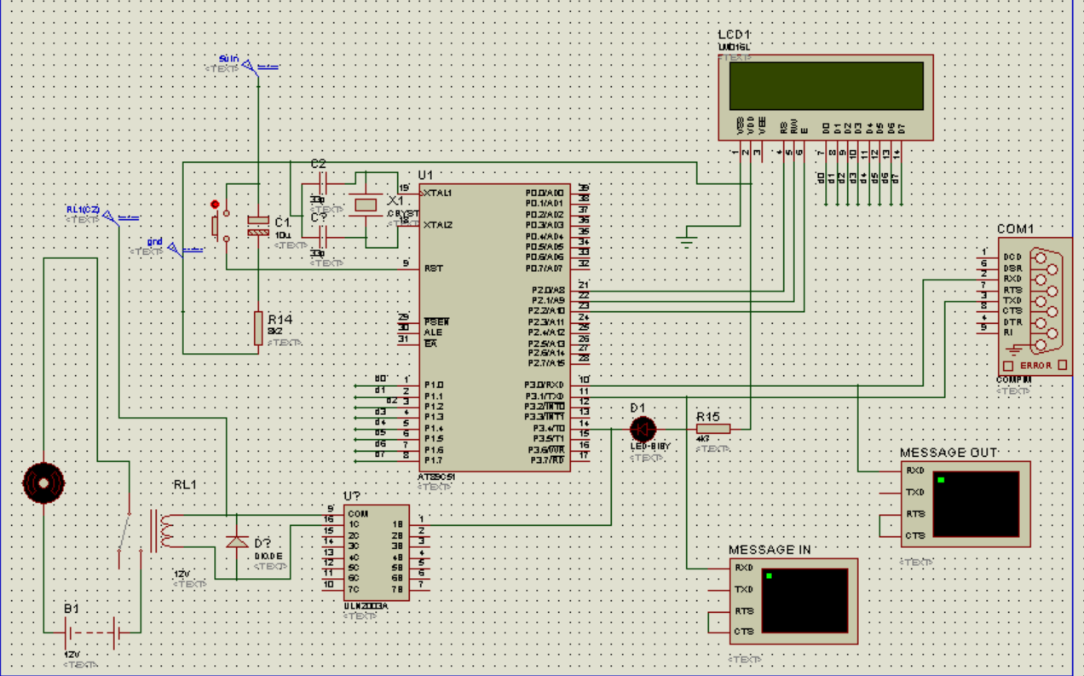
SMS BASED WATER PUMP CONTROLLER
CIRCUIT DIAGRAM

Slide 9
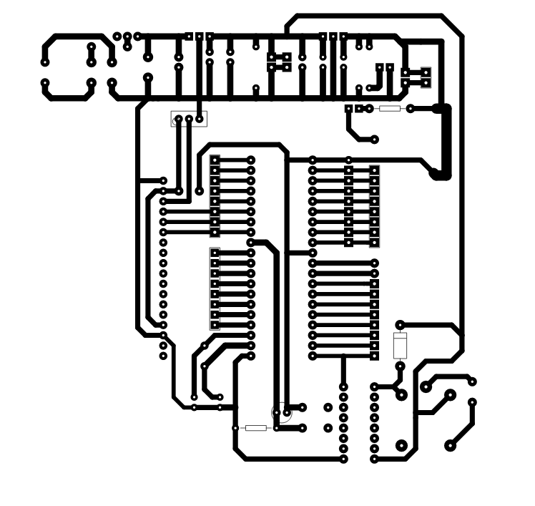
PCB LAYOUT

Slide 10
SMS BASED WATER PUMP CONTROLLER
WORKING OF PROJECT :
The working of this project controlled by microcontroller NXP P89V51 RD2 and GSM modem is used for receiving and transmitting message.
PROJECT WORKS IN THE FOLLOWING WAYS:
->Interface the all circuitarry as per connection.
->Send SMS on GSM module SIM number , to ‘START’ or ‘STOP’.
->The user can send MSG goes on to the GSM module .
->This mMSG read by controller and activate output through relay. ->From above procedure microcontroller take decision to turn ON or turn OFF water pump motor.

Slide 11
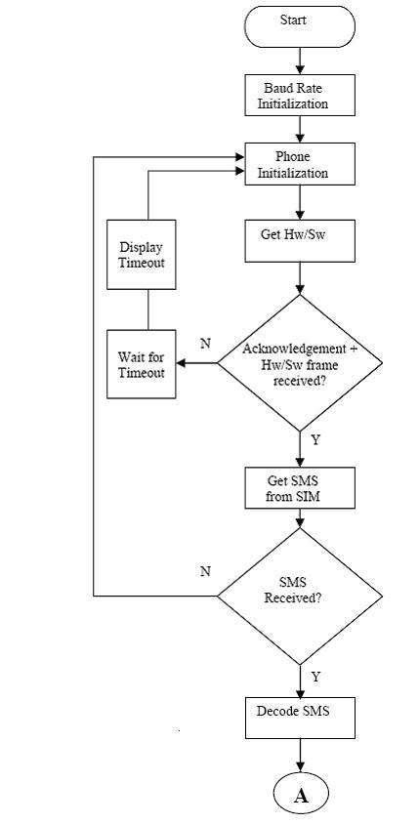
SMS BASED WATER PUMP CONTROLLER
FLOW CHART

Slide 12
SMS BASED WATER PUMP CONTROLLER
ADVANTAGES :
The user can control the water pump from anywhere by sending SMS(not limit of distance).
By using one microcontroller one GSM modem we can control multiple devices and its operation.
Easy to operate and it is gives protection from shock.
User can send commands using internet also , through various free sms sending websites.
Cheaper : SMS services are generally cheap and are sometimes provided for
free (at least for certain periods) by service providers. Furthermore, most service providers do not charge users for receiving SMS.

Slide 13
SMS BASED WATER PUMP CONTROLLER
DISADVANTAGES:
System failure if
->No network
->No power from mains
SIM needs to be recharged
24 x 7 power consumption

Slide 14
SMS BASED WATER PUMP CONTROLLER
AREA OF APPLICATION:
This project is generally used for agriculture purposes.So,
it has a widespread application in this field.
It will be also used in industrial application for switching different type of machineries.
FUTURE SCOPES :
More than one devices can controlled using same circuit , if other unused port are used efficiently.
The user can control the device by dialing tone from anywhere.

Slide 15
SMS BASED WATER PUMP CONTROLLER
REFERENCES
-> Muhammad Ali Mazidi , Janice Gillispi Mazidi , Rolin D. Mckinly.
second edition , “ THE 8051 MICROCONTROLLER AND EMBEDDED SYSTEM ”
WEBSITES
->www.google.com
->www. 8051project.com

